Slide 1
Android Meal Tracker
Health Pal for CHF Patients
Holly Williams, Mingrui Ji, Esther Lee

Slide 2
What is CHF?
Congestive Heart Failure
The heart’s pumping power is weaker than normal. As a result, the kidneys may respond by causing the body to retain more fluid (water) and salt and the body becomes congested.
Adherence to a good diet plan and reduction of salt intake are extremely important for CHF patients.

Slide 3
Our App
Overview:
Improve health exchange between CHF patients and physician
Monitor food and activity
“You are what you eat” -Victor Lindlahr
Main ideas:
Meal Tracker
Calculate Score
Send alert and report

Slide 4
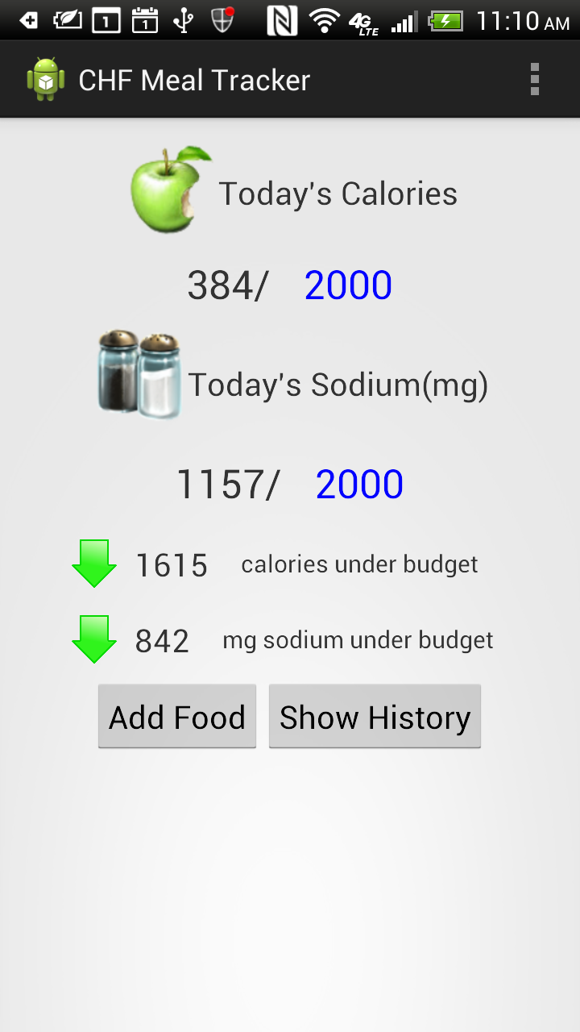

Slide 5
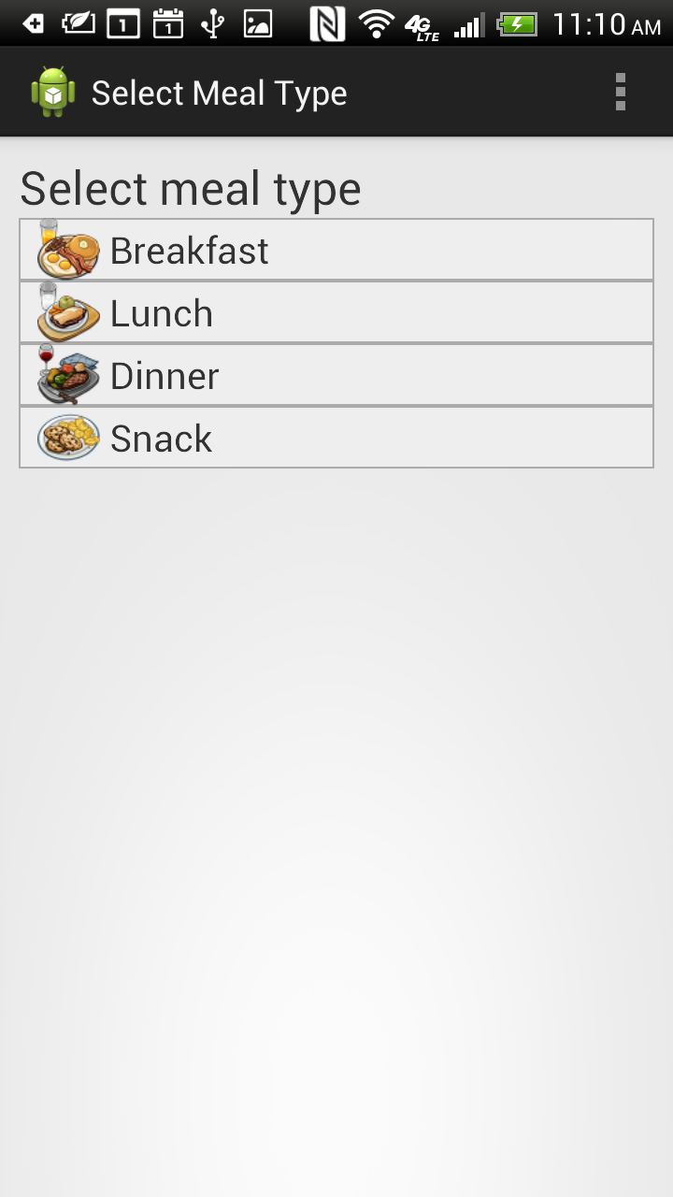

Slide 6
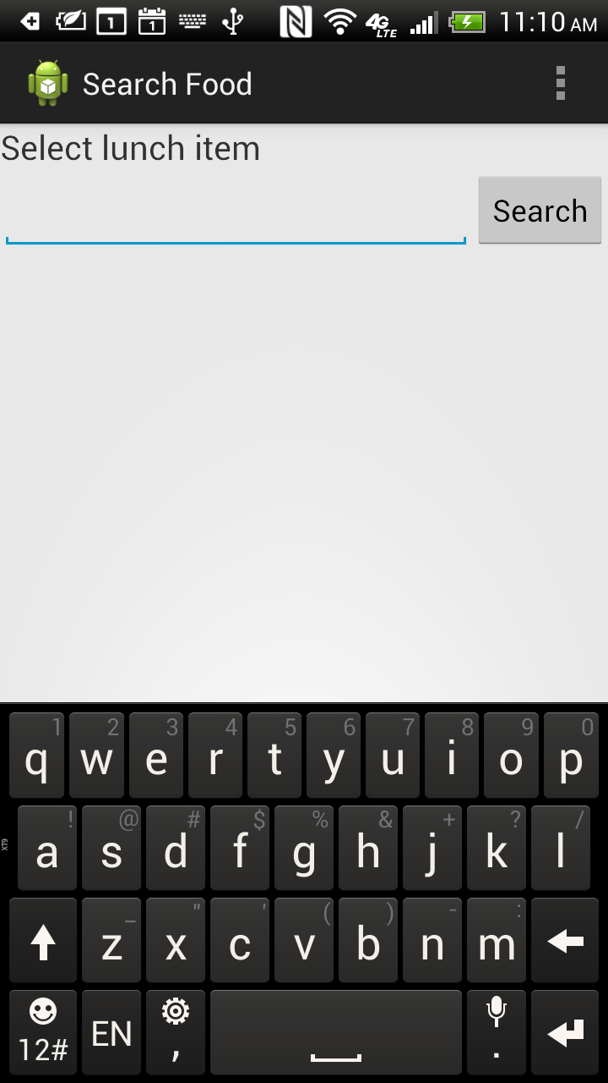

Slide 7
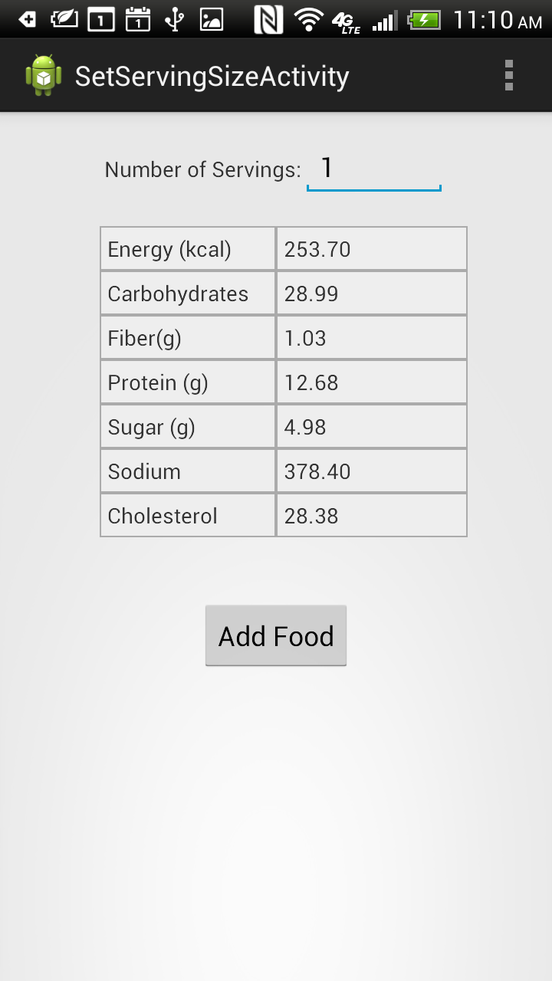

Slide 8
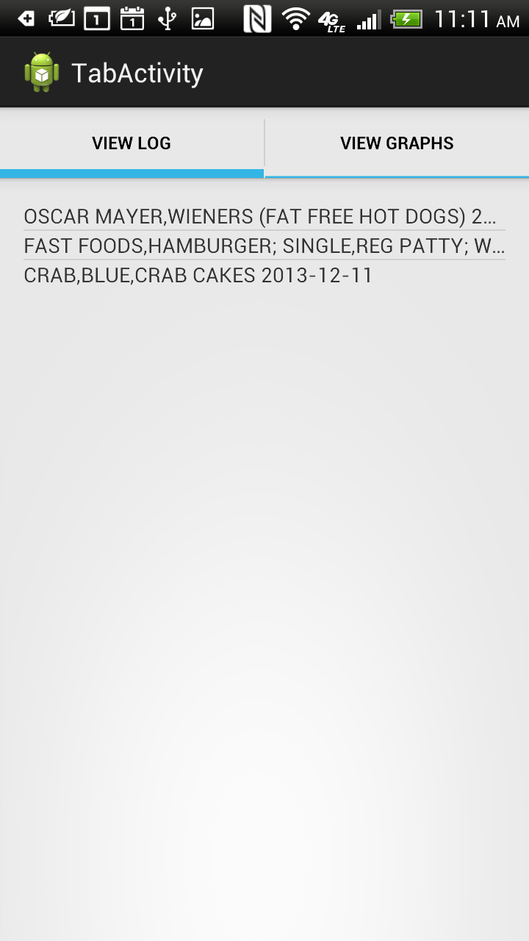

Slide 9
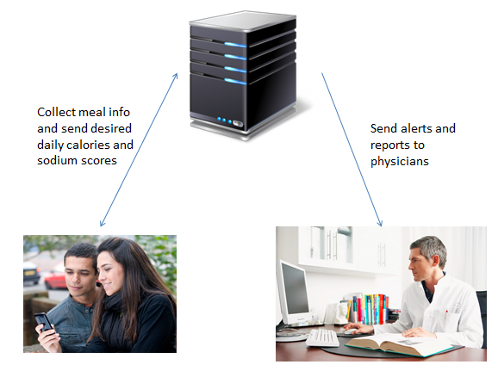
System Architecture

Slide 10
Implementation
Mobile part:
Android 4.2 with Sqlite
Server part [hit1.nimbus.cip.gatech.edu]:
PHP
MySql [remote access to MySql on hit4]
RESTful APIs:
Get Desired Scores [Post, PatientID]
Sync Meals [Post, PatientID, new meals]
SendMessage from HIE group
SendReport from HIE group

Slide 11
Methodology
Sync Meals
Users add each meal to local database. USDA food database is used for searching. Daily scores are updated based on the new added meals.
After a new meal is put into local database, whenever there is internet connectivity, sync the new meals to server.
Get Desired Calories and Sodium Intake Amount
Get patient’s medication info from EHR
If there is no medication info available, default values are sent back. [calories=2,000, sodium=2,000]
Send Alerts & Reports to EHR
Actual calories and sodium intake amount is compared with the desired one. If either of the desired scores is above the budget, send alert & report (with visualization of meal history) to EHR.

Slide 12
Database Design
3 tables (phone):
USDAfood (INT ID; TEXT food_name; REAL water_g; REAL calories; REAL protein_g;REAL carbohydrate_g; REAL fiber_g; REAL sugar_g; REAL calcium_mg; REAL sodium_mg, REAL cholesterol, REAL gmwt1, TEXT gmwt1_desc, REAL gmwt2, TEXT gmwt2_desc)
Scores (DATE creation_date, REAL calories, REAL sodium)
Meals (DATE creation_date, REAL serving_size, INT meal_type, REAL sodium, REAL calories, INT meal_synced)

Slide 13
Database Design
2 tables (server):
Scores (INT patientID, DATE creation_date, REAL calories, REAL sodium)
Meals (INT PatientID, DATE creation_date, REAL serving_size, INT meal_type, REAL sodium, REAL calories, INT meal_synced)

Slide 14
Alert & Report Format
SendMessage:
PatientID
RecipientID
Subject: Meal Alert
Message Body: “Calories intake is above budget XXX calories on [date] for XXX calories. Sodium intake is above budget XXX mg on [date] for XXX mg.
Priority: High
SendReport:
PatientID:
Base64Document: A PDF file with meal history graph
DocumentName:

Slide 15
Q&A

